Slide 1
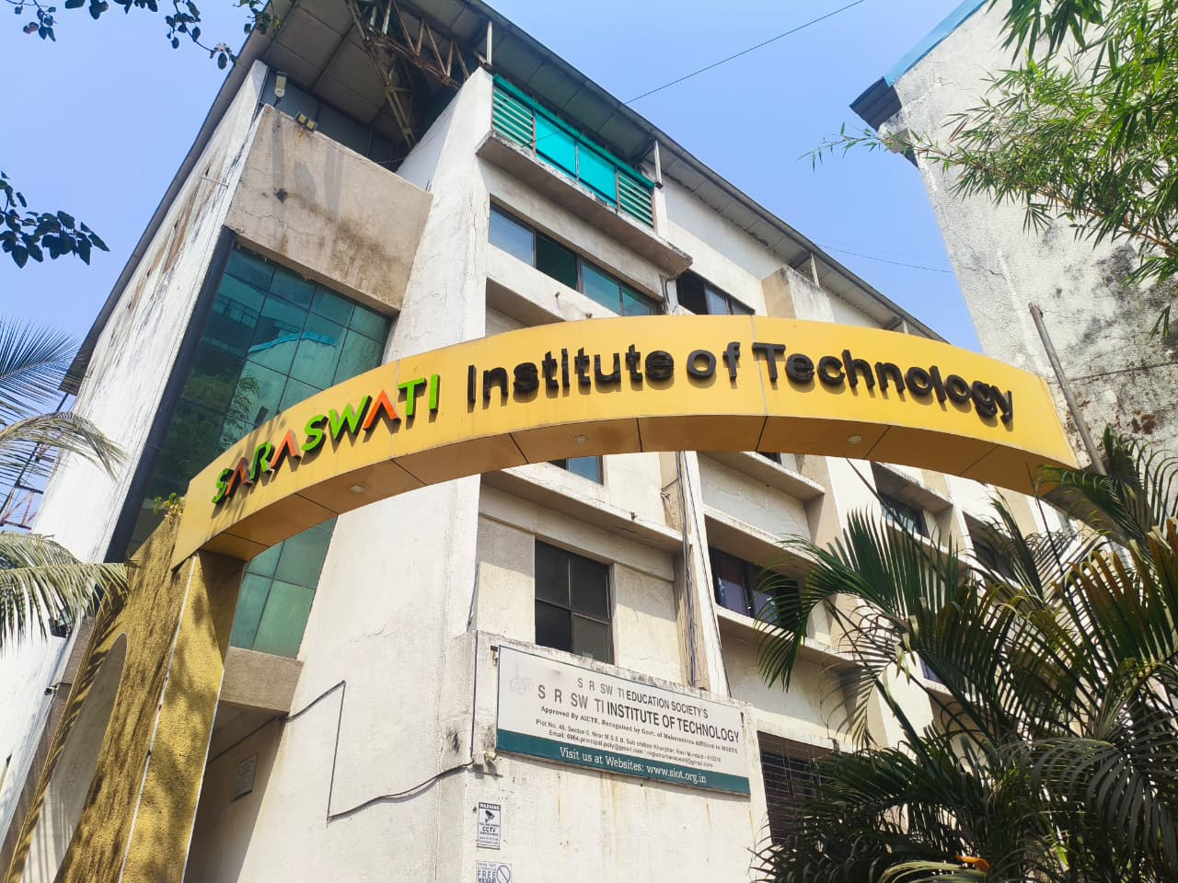
DEPARTMENT OF
CIVIL ENGINEERING
NEWSLETTER 2025 – 26
Saraswati Institute of Technology, Kharghar, Navi Mumbai
DTE CODE: 3281
Learn · Live · Achieve · Contribute

Slide 2
VISION & MISSION
VISION
MISSION
To impart quality technical education beneficial to industry and the society in the field of Civil Engineering.
To arrange academic and technical expertise.
To improve the practical knowledge of the student as per the current scenario of the industry.
To make the students socially and ethically responsible.

Slide 3
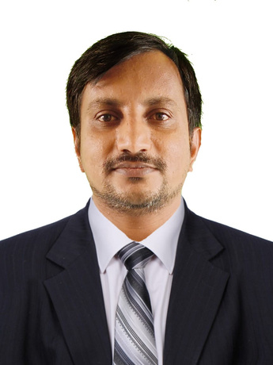
HOD'S DESK
Building Sustainable Infrastructure for the Future
Civil Engineering is one of the oldest branches of engineering dealing with the planning, design, construction, and maintenance of infrastructure essential for modern society. With rapid urbanization, population growth, and technological advancement, the demand for safe, durable, and sustainable infrastructure has increased significantly.
The department focuses on providing strong theoretical knowledge combined with practical exposure in core domains such as Structural Engineering, Geotechnical Engineering, Transportation Engineering, Environmental Engineering, Surveying, and Construction Management.
The department emphasizes modern tools such as CAD, Building Information Modeling (BIM), GIS, and advanced construction materials — preparing students to become competent professionals contributing to national development.
Mr. Dattatray Bangar
HOD — Civil Engineering
Saraswati Institute
of Technology

Slide 4
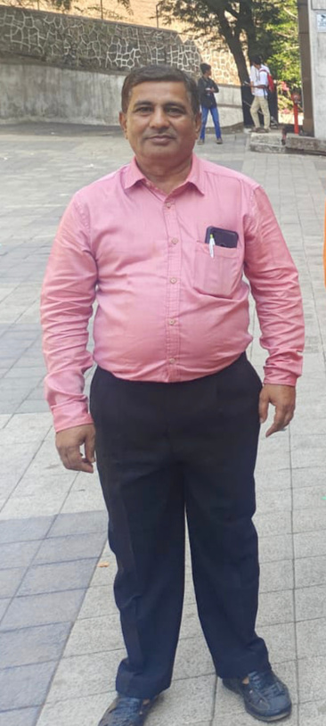
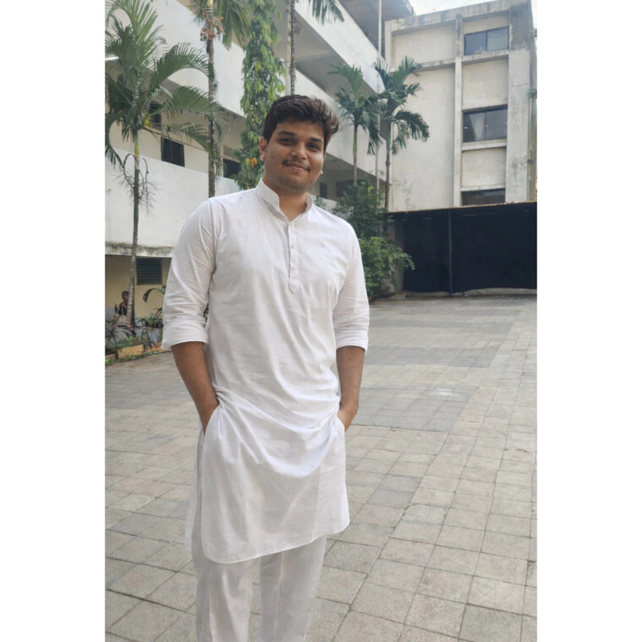
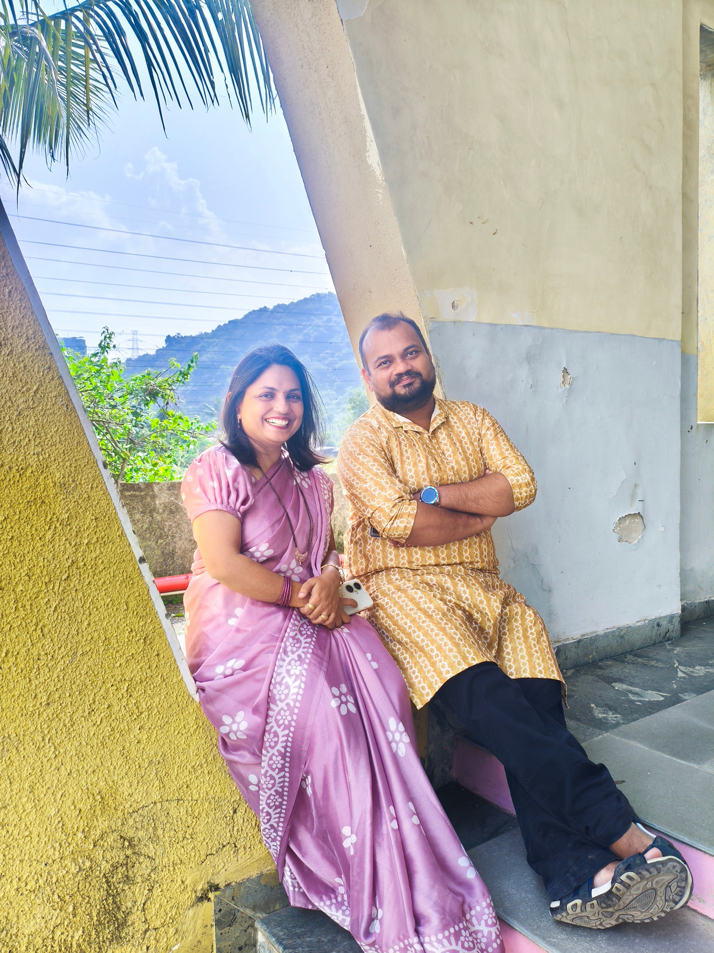
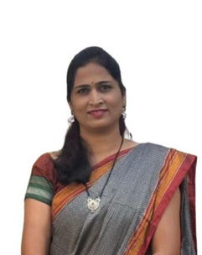
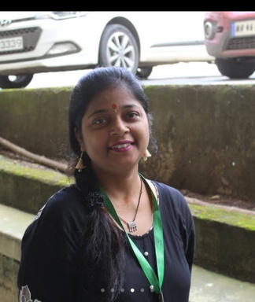
FACULTY PROFILE
DR.
SUROSHE
Dr. D. R. Suroshe
Principal
Mr. Dattatray Bangar
Mrs. Pranjali Chafale
Mr. Rajesh Ingole
Mr. Hritik Sonawane
Mr. Shashikant Hegonde
HOD Civil Dept.
Lecturer
Lecturer
Lecturer
Lecturer

Slide 5
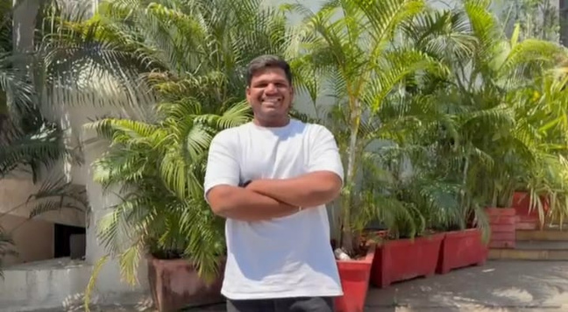
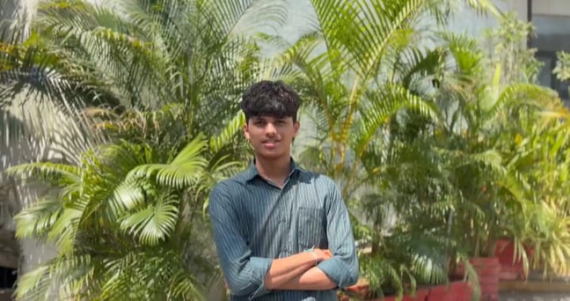
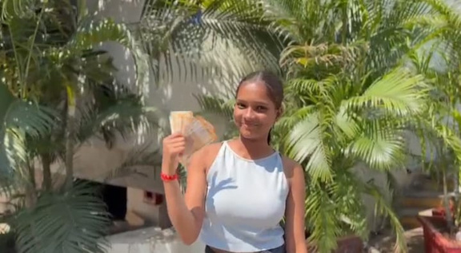
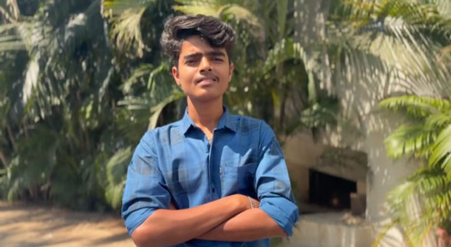
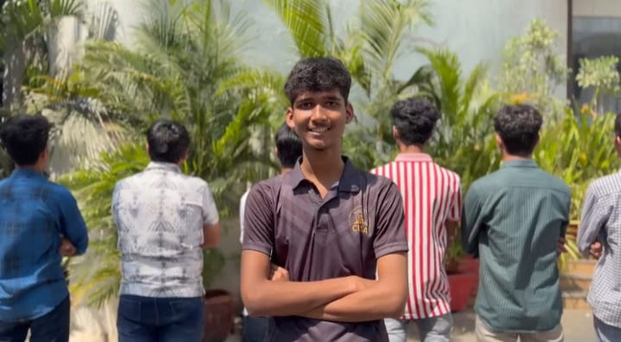
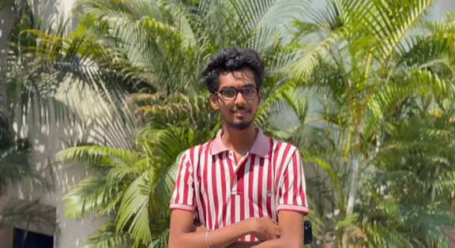
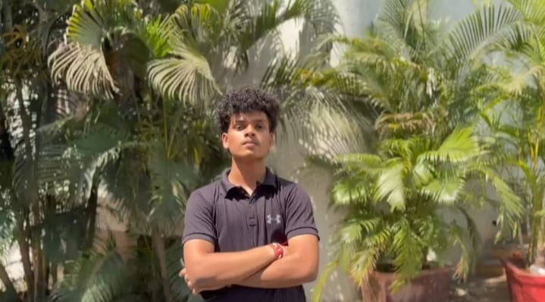
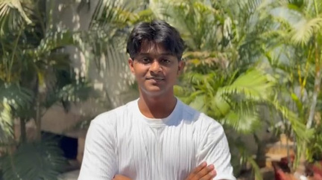
CESA 2025-26
Civil Engineering Students Association
More Akash
Jaiswal Arvindra
Parse Tanushka
Bharti Om
President
Vice President
Treasurer
Co-ordinator Head
Naik Rahul
Chandane Yadnesh
Gavhane Aryan
Patil Shreeraj
Media Head
Technical Head
Sports Head
Discipline Head

Slide 6
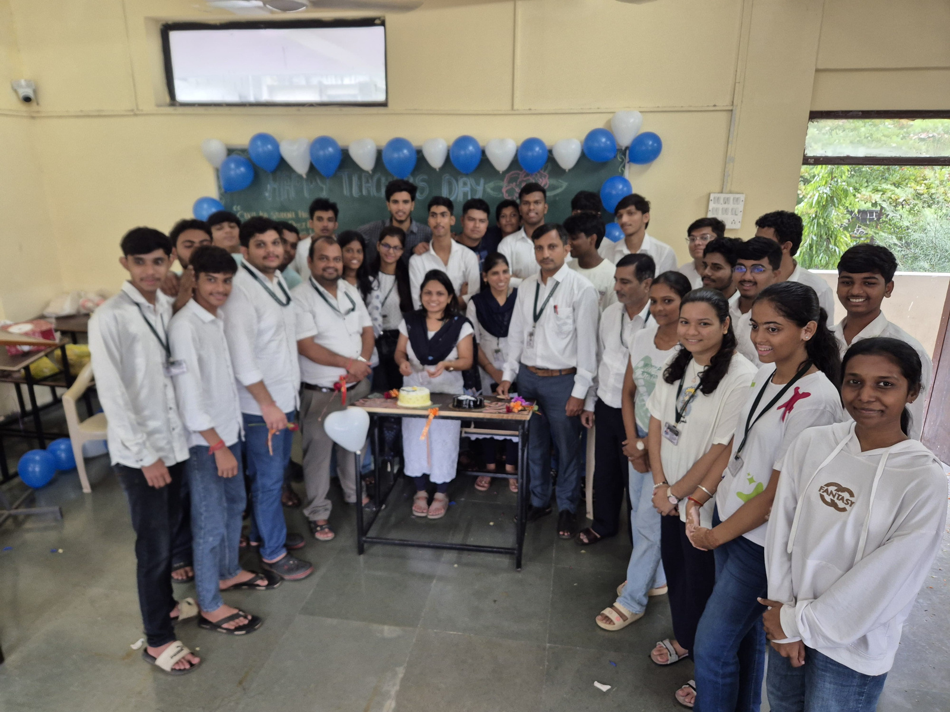
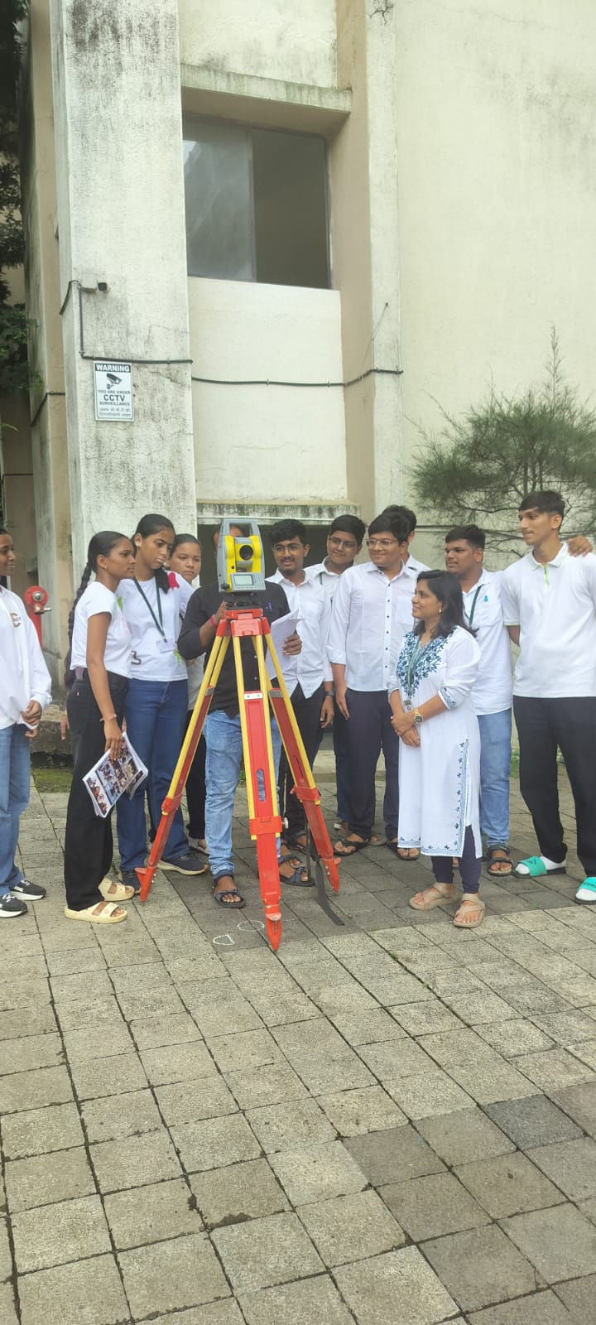
EVENTS — ACADEMIC YEAR 2025-26
Teacher's Day
Emerging Surveying Technology
5th September 2025
18–19 September 2025
Students of the Civil Engineering department celebrated Teacher's Day with inspiring speeches, cultural performances, and interactive sessions to honor faculty contributions.
Expert lecture for 2nd Year students on modern surveying techniques including Total Station, GPS, and drone surveying at SIOT Ground.

Slide 7
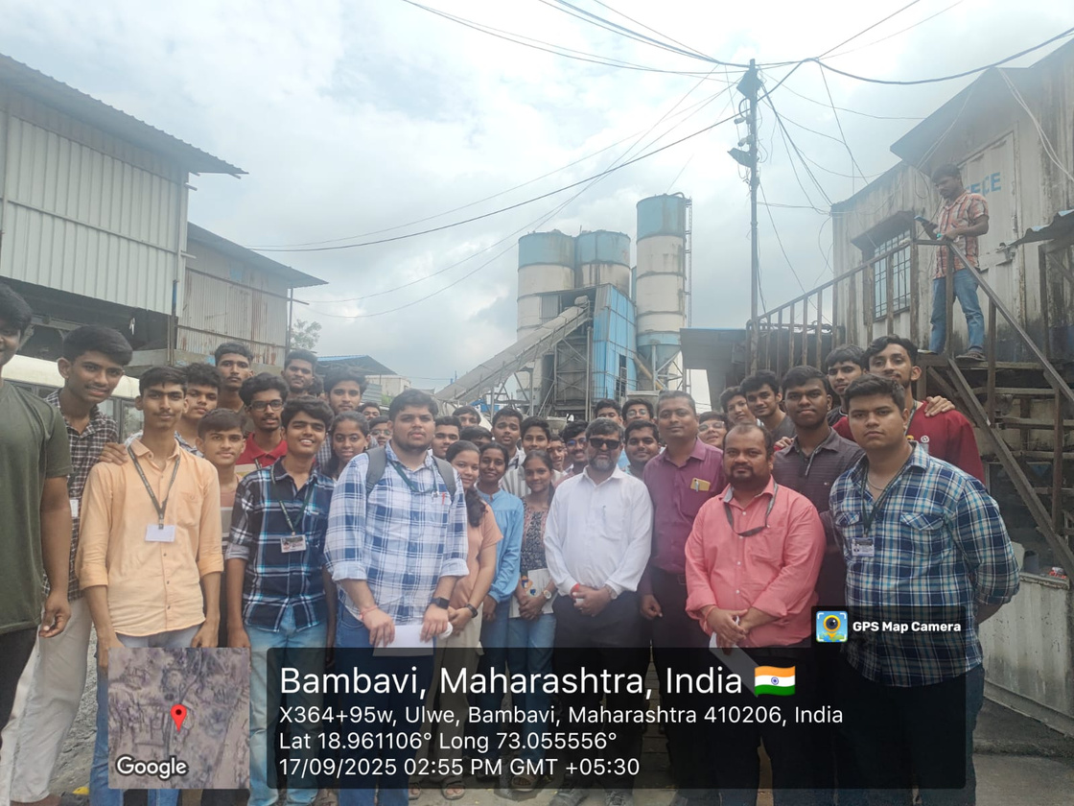
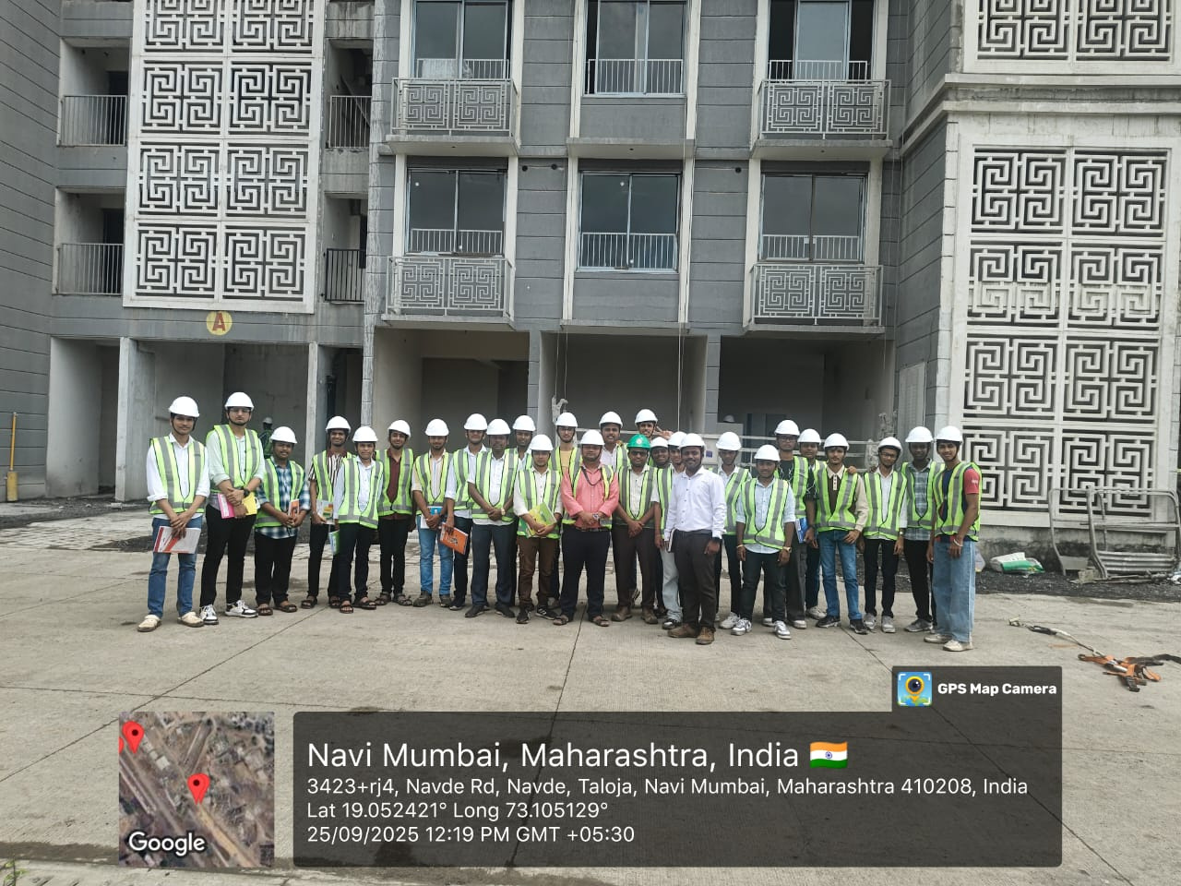
EVENTS — INDUSTRY EXPOSURE
Industrial Visit — RMC Plant
Civil Workshop — Site Visit
17 September 2025 | Omkar Construction, Ulwe
25 September 2025 | B.G. Shirke Pvt. Ltd., Navde
2nd Year students visited the Ready Mix Concrete Plant to observe batching, mixing, and transportation of concrete and understand quality control processes.
1st Year students visited a live CIDCO construction site to gain first-hand exposure to construction activities, site management, and safety practices.

Slide 8
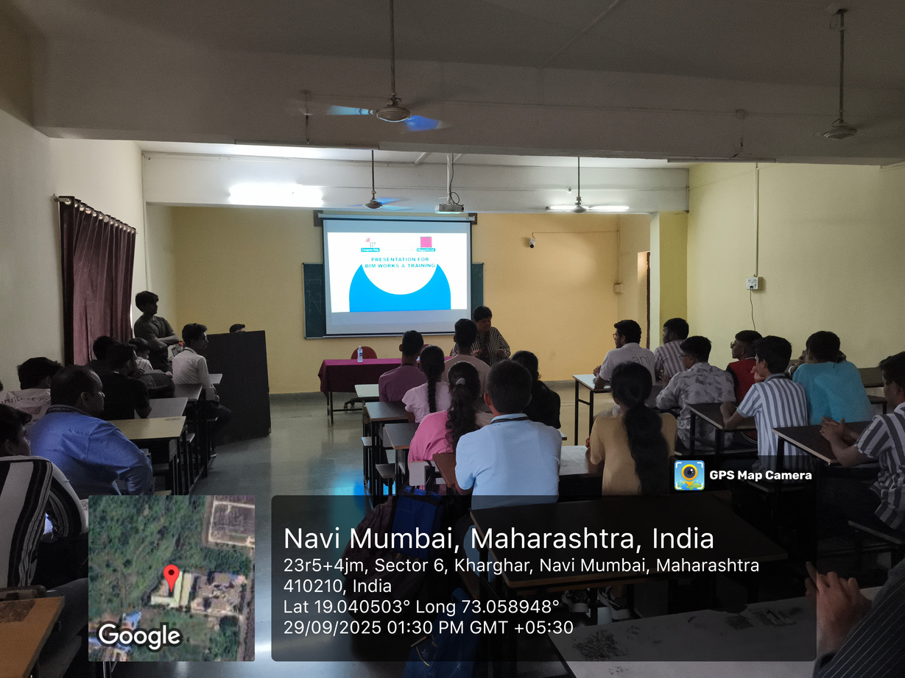
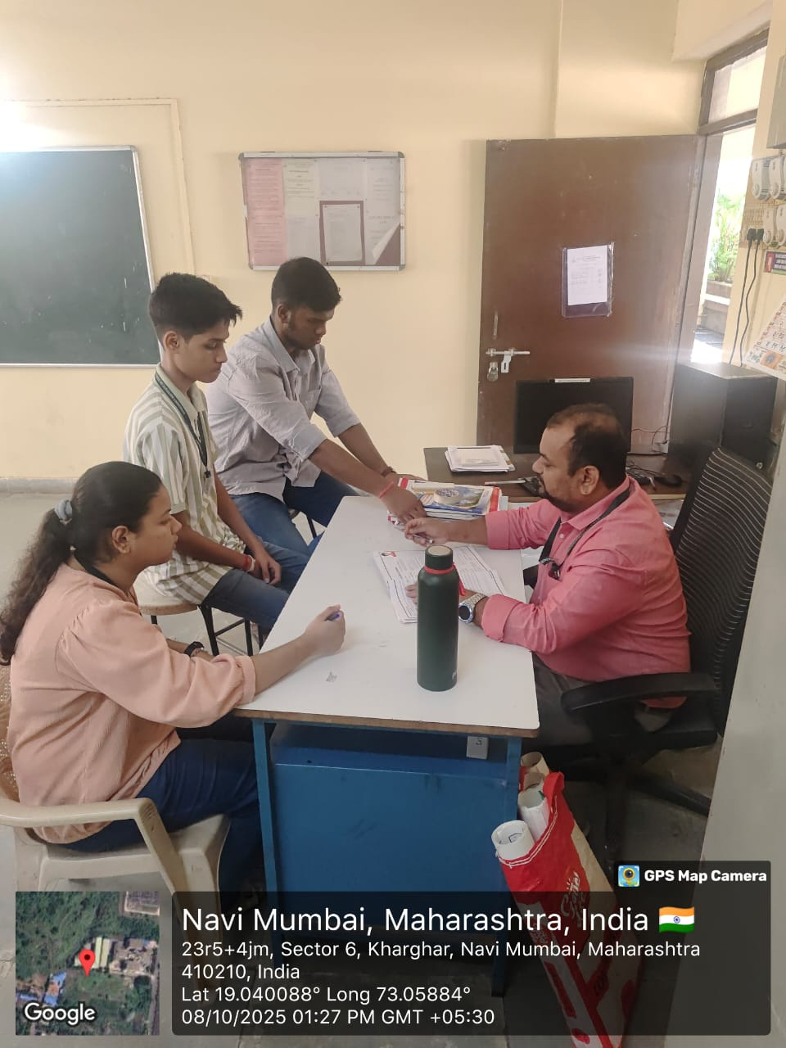
EVENTS — TECHNICAL & MENTORSHIP
Expert Lecture — BIM
Mentor–Mentee Meetings
29 September 2025 | SIOT Seminar Hall
Regular Sessions — Academic Year 2025-26
Session on Building Information Modeling (BIM) for 2nd and 3rd Year students, covering digital construction techniques and BIM applications in modern engineering.
Faculty mentors guide students on academic performance, technical skill development, time management, and career aspirations in civil engineering.

Slide 9
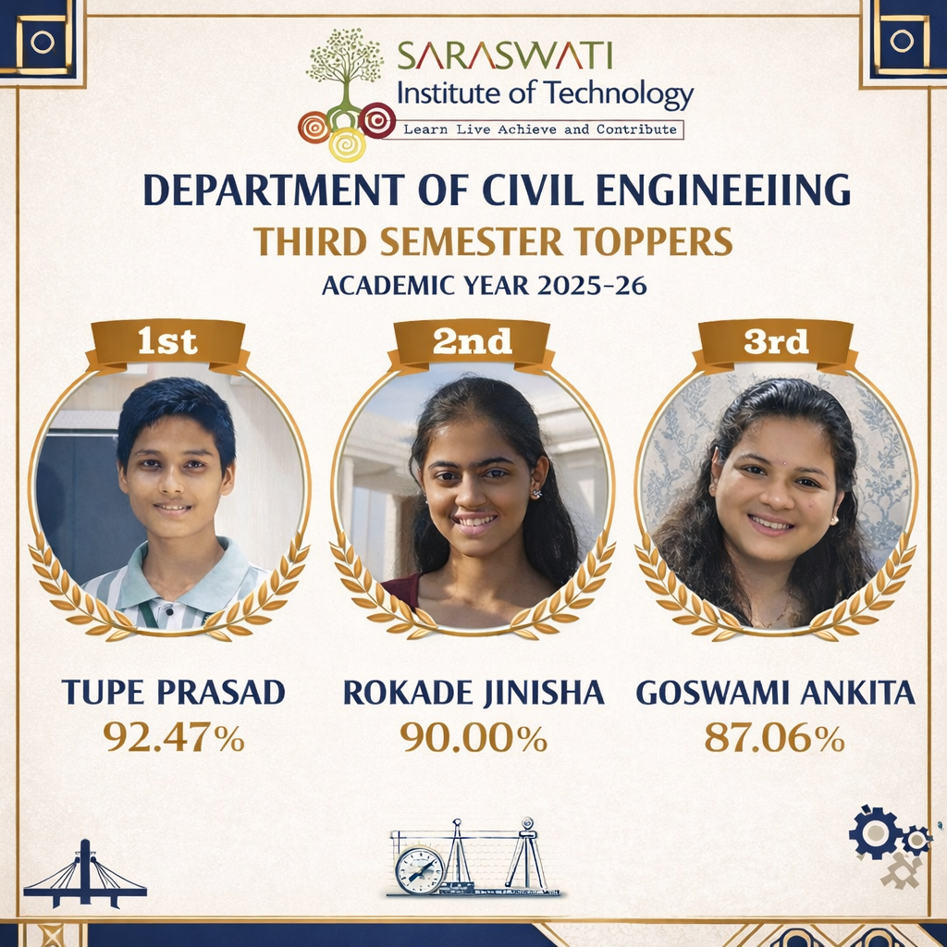
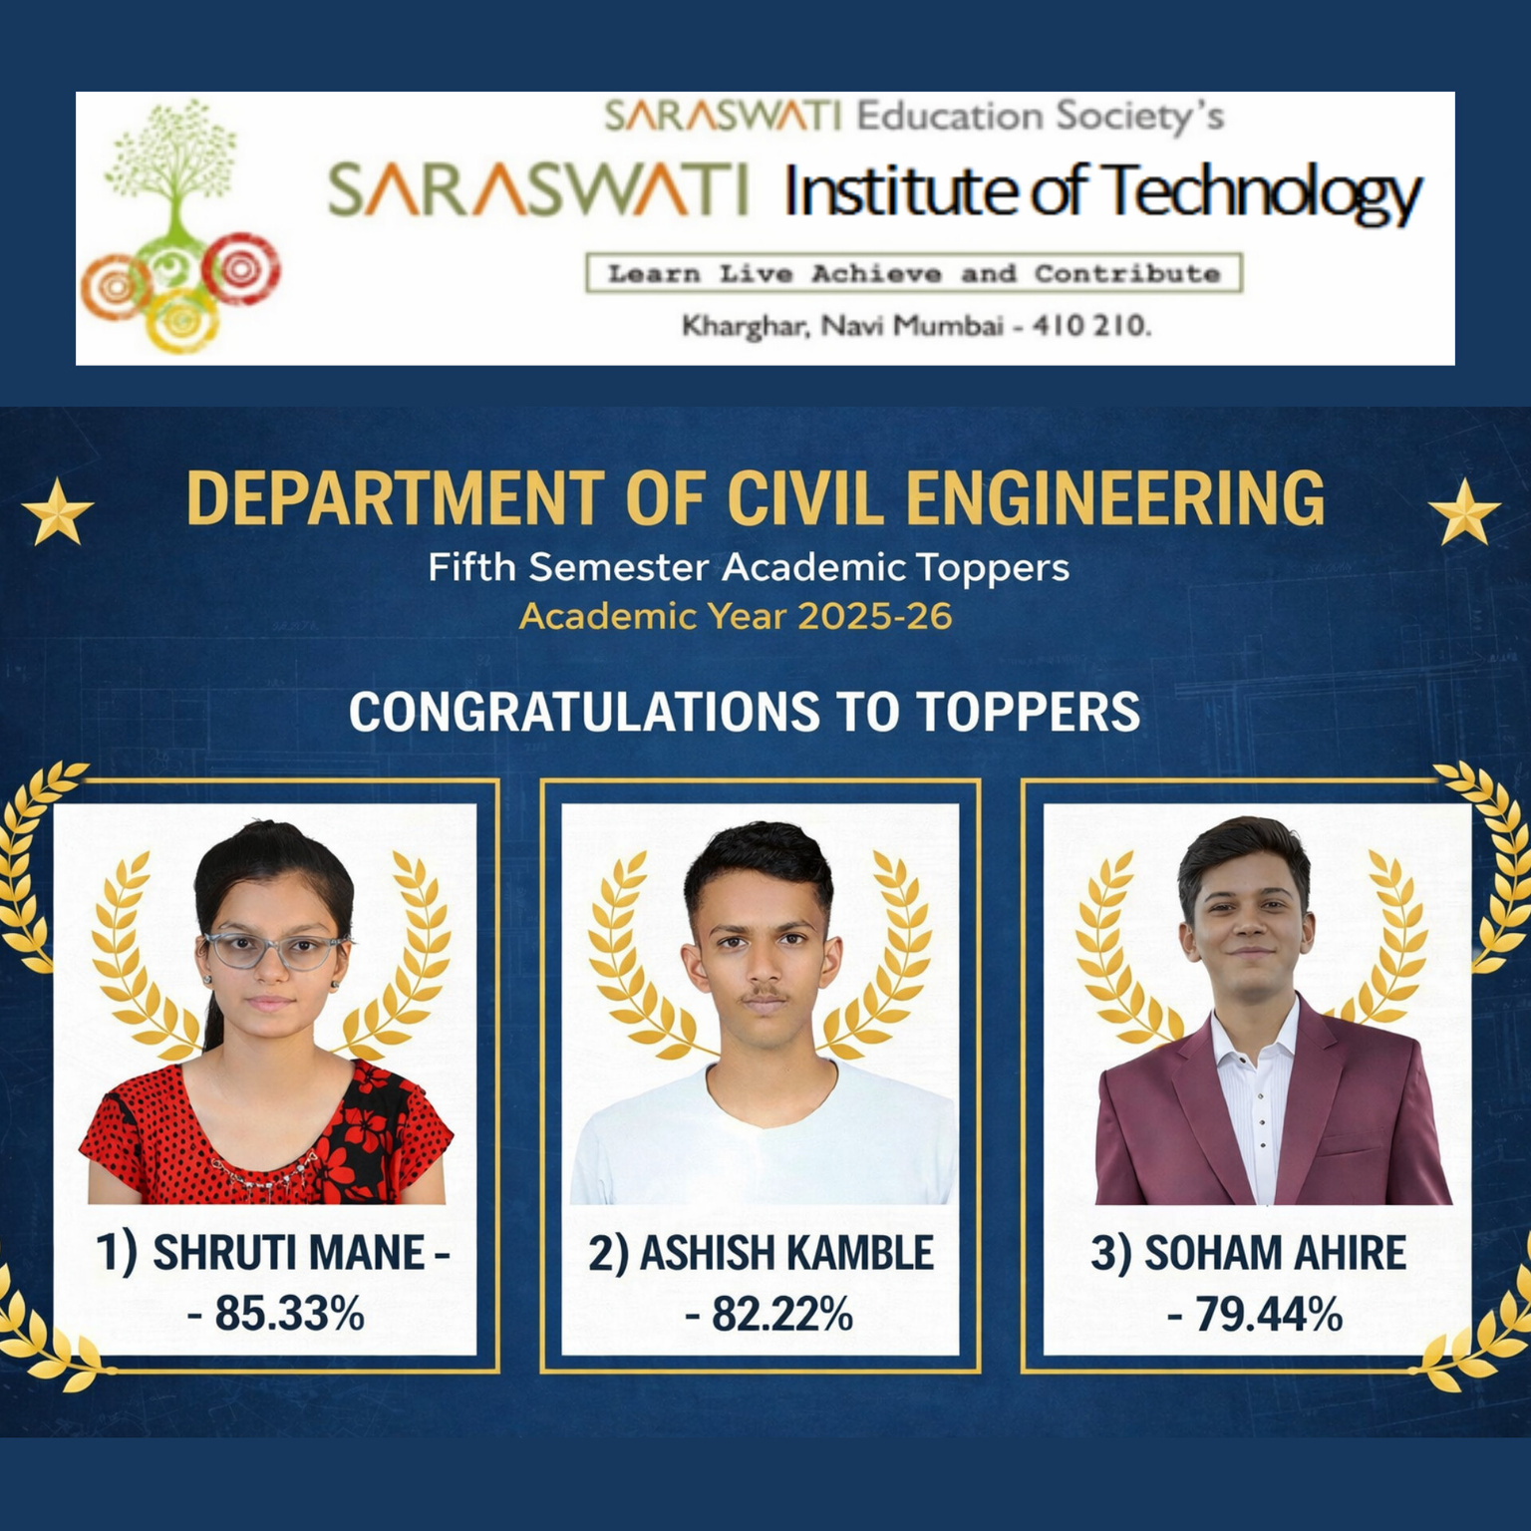
ACADEMIC TOPPERS — 2025-26
Fifth Semester Toppers
Third Semester Toppers
1st
2nd
3rd
1st
2nd
3rd
Shruti Mane
Ashish Kamble
Soham Ahire
Tupe Prasad
Rokade Jinisha
Goswami Ankita
85.33%
82.22%
79.44%
92.47%
90.00%
87.06%
Percentage
Percentage
Percentage
Percentage
Percentage
Percentage

Slide 10
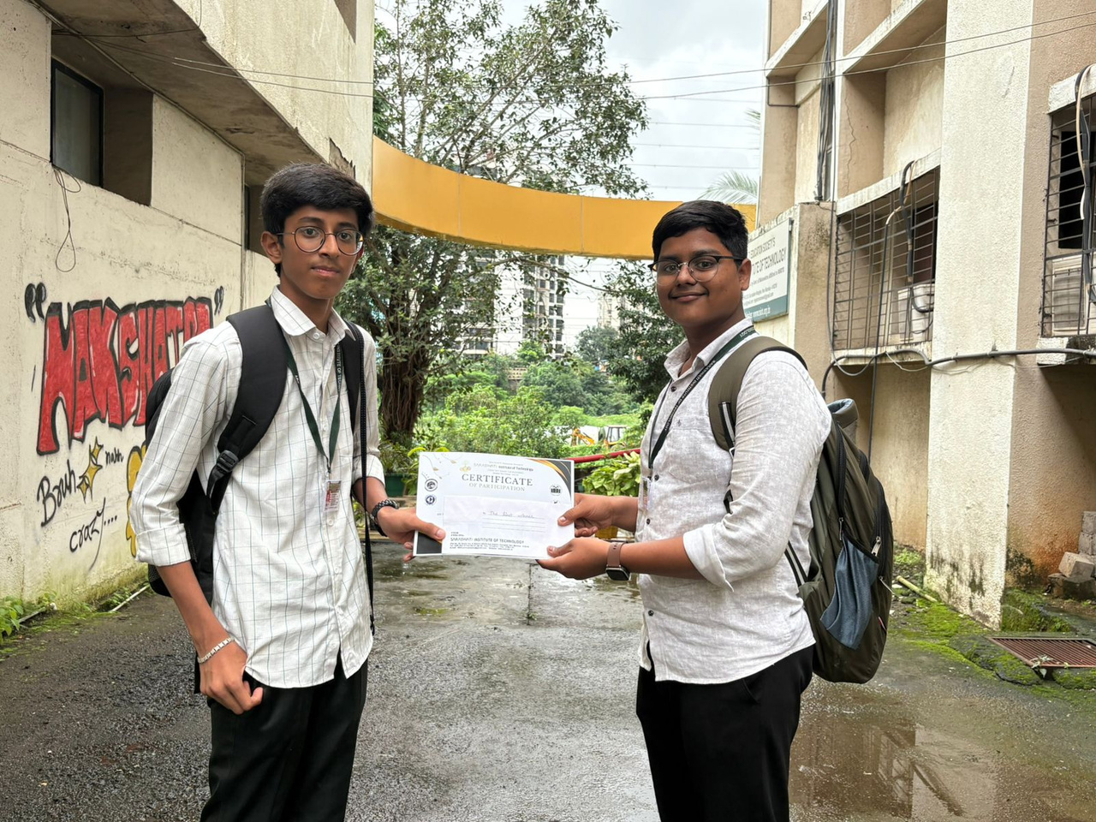


ACHIEVEMENTS
CONTACT US
Phone:
+91 9769344371
Email:
dattatray.bangar@sce.edu.in
Technical Poster Competition
Website:
www.siot.org.in
State Level — Academic Year 2025-26
Instagram:
@siotcesa
Students participated and excelled at the State Level Technical Poster Competition, demonstrating their research and presentation skills.
Address:
Plot No. 46, Sector 5, Kharghar, Navi Mumbai - 410210

